Slide 1
TIME MANAGEMENT
“Time is a non renewable resources once it’s gone , it is gone.”
By Sana

Slide 2

DEFINATION
Time Management refers to managing time effectively so that the right time is allocated to the right activity.

Slide 3

Introduction
Effective time management allows individuals to assign specific time slots to activities as per their importance.
Time management refers to making the best use of time as time is always limited.

Slide 4
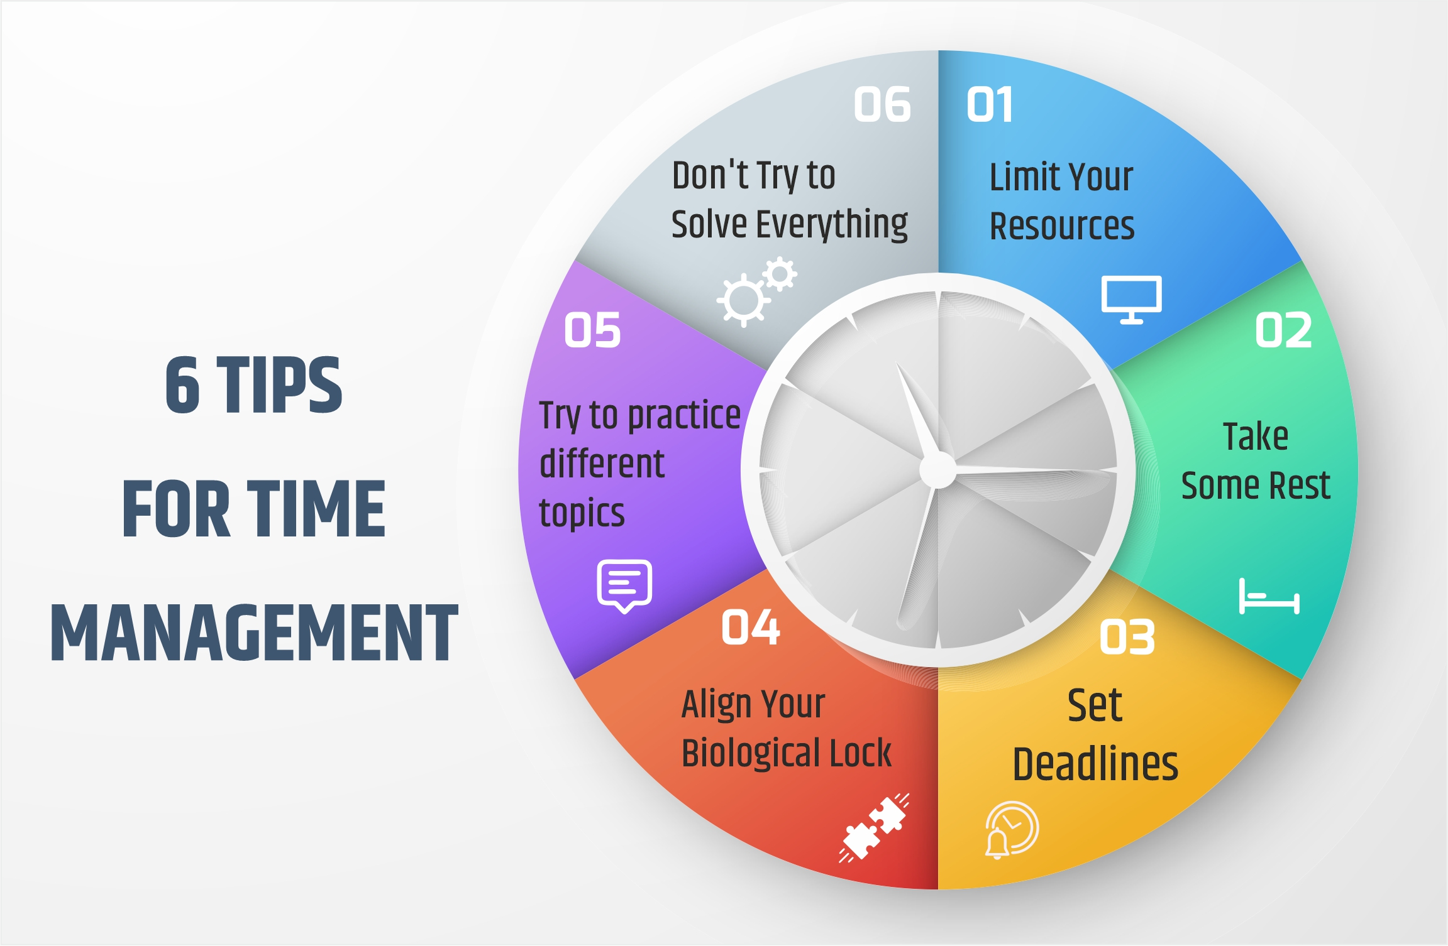

Slide 5
Time Management Techniques
Effective Planning:
Plain your day well in advance. Prepare a To Do list or a “Task Plan.” jot down the important activities that need to be done in a single day against the time that should be allocated to each activity.
Setting Goals and Objective:
Working without goals and targets in an organization would be similar to a situation where the captain of the ship loses his way in the sea yes, you would be lost. Set targets for your self and make sure they are realistic one and achievable.
Setting Deadline:
Set deadline for yourself and strive hard to complete task a head of the deadline. Do not wait for your superior to ask you every time. Learn to ownership of work.
One person who can best set the deadline is you your self. Click here. https://corporatefinanceinstitute.com/resources/management/time- management-list-tips/

Slide 6
Time Management Skills
Stay Organized:
The workstation must be kept clean and organized.
Do not keep stacks of files and heaps of paper on your desk.
Learn to Prioritize:
High priority tasks must be attended to immediately.
Be Punctual and Disciplined:
Be punctual helps you complete tasks way ahead of deadline.
Avoid taking too many leaves from work. Such an attitude is completely un professional.
Take Ownership of work:
Be responsible for your work and learn to accept your mistake.
If you have accepted something ,then it becomes your responsibility to complete it within the allotted times slot.
Be a Little diplomatic:
Do not accept everything which comes your way. A polite “NO” in the beginning will save your reputation later.

Slide 7
Your productivity increases
More confident
You reach your goals
The Benefit of Time
Management
You achieve balance in your life
You improve your self
You reduce your stress
Positive reputation

Slide 8
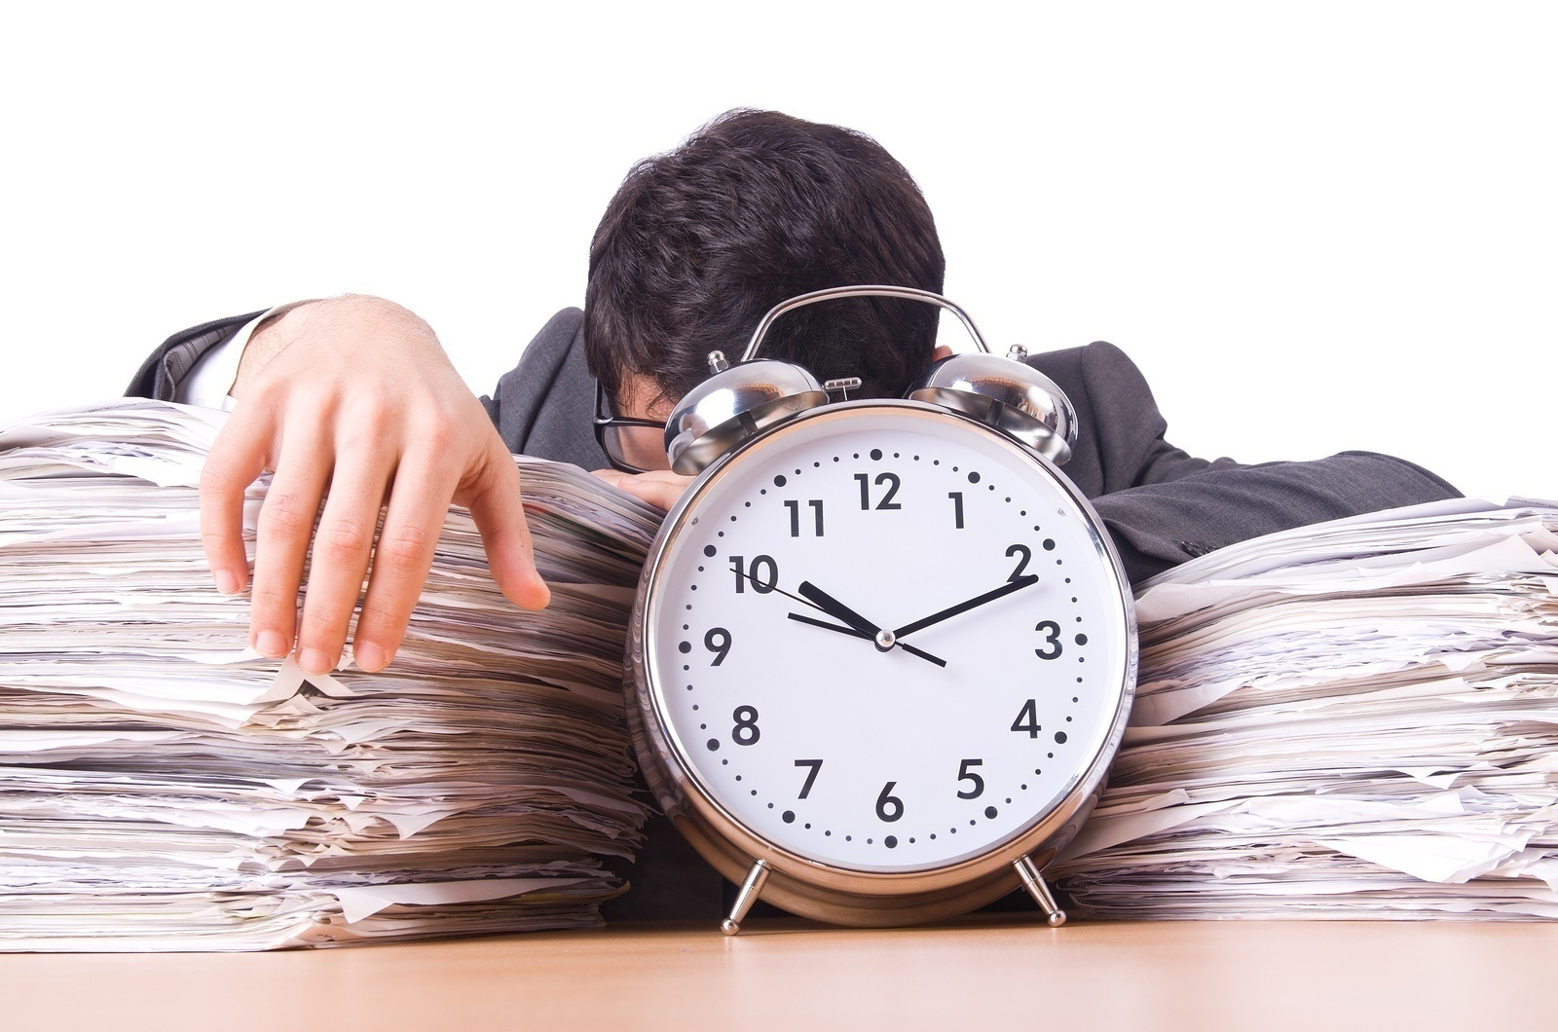

Implication Of Poor Time Management
Poor work flow
Wasted Time
Loss of Control
Poor quality of Work
Poor Reputation
This Photo by Unknown Author is licensed under CC BY-SA-NC

Slide 9
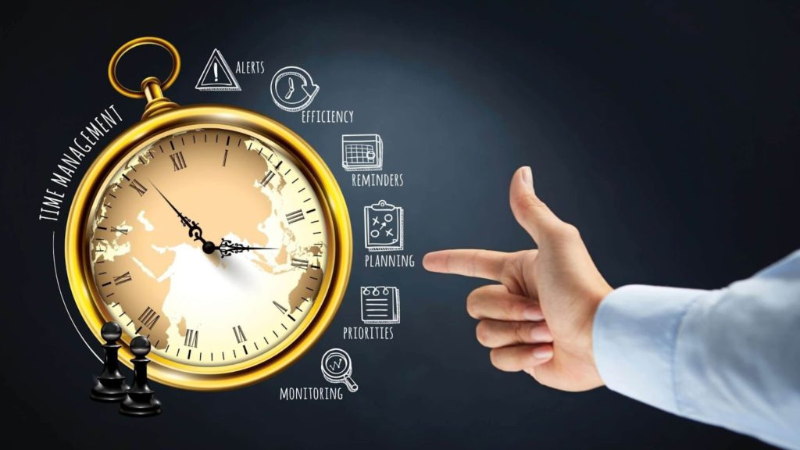
Conclusion
Time management is the process of organizing and planning how to divide your time between different activities. Get it right, and you’ll end up working smarter, not harder, to get more done in less time-even when time is tight and pressures are high. The highest achiever manage their time exceptionally well.

Slide 10
THANK YOU FOR YOUR ATTENTION

